Slide 1

Thinking about Social Phenomena Constructing Puzzles
Dr. Raheel Dhattiwala

Slide 2

Social phenomena
Inequality
Education, gender, workplace, identity

Slide 3

Social phenomena
Family
Marriage, divorce, kinship

Slide 4
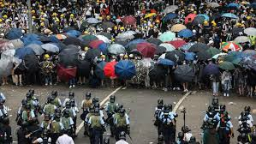
Social phenomena
Conflict
Protests, violence, identity, crime

Slide 5
Institutions and the individual
Institutions (macro/context) → complex
Individual (micro/action)

Slide 6
Institutions and the individual
Institutions (macro/context) → complex
Interaction, between & within
Individual (micro/action)

Slide 7
Institutions and the individual
Institutions (macro/context) → complex
Evolution
Interaction, between & within
Individual (micro/action)

Slide 8
What is a puzzle?
When we have a well-established fact or event to which we do not have a well-established explanation→ ‘puzzle’
Counterintuitive fact, e.g. littering
An unexplained correlation, e.g. alcoholism and parenting

Slide 9
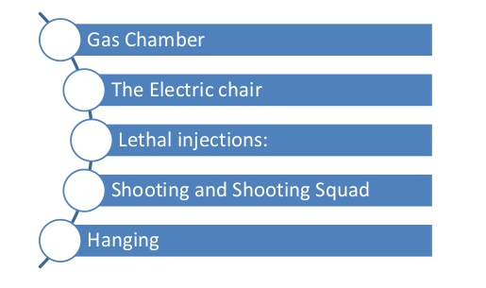
What is a sociological question?
FACT: 65% Indians support capital punishment

Slide 10
What is a sociological question?
FACT: 65% Indians support capital punishment
How did these people come to support capital punishment?
Attitudes

Slide 11
What is a sociological question?
FACT: 65% Indians support capital punishment
How did these people come to support capital punishment?
Attitudes
Changes over time
Differences across populations

Slide 12
Question for you

Slide 13
Puzzle
Why may harsh punishments increase the behaviour they target?

Slide 14
Functional explanations
Explaining a phenomenon from consequences
Phenomenon persists because of consequence: Evidence?
Why do we have chairs? To sit.
Why do we sit? So that we can have chairs.
Tautology

Slide 15
Functional explanations
Punishment → reduced crime
Crime→ social cohesion (punishment a means): e.g. Emile Durkheim
Explain from prior events and facts
Poverty?
Discrimination?
Mental health?

Slide 16

The ‘billiard ball’ model of causation: David Hume
One billiard ball striking another: sequence over repeated experiences
→ But what causes the ‘cause’?

Slide 17
Readings for Thursday
Elster, Jon. 2007. Explaining Social Behaviour: More Nuts and Bolts for the Social Sciences. Cambridge: Cambridge University Press. (Chapter 1 ‘Explanation’).
Watts, Duncan. 2014. ‘Common sense and sociological explanations’ American Journal of Sociology, 120 (2): 313-351.

